Slide 1

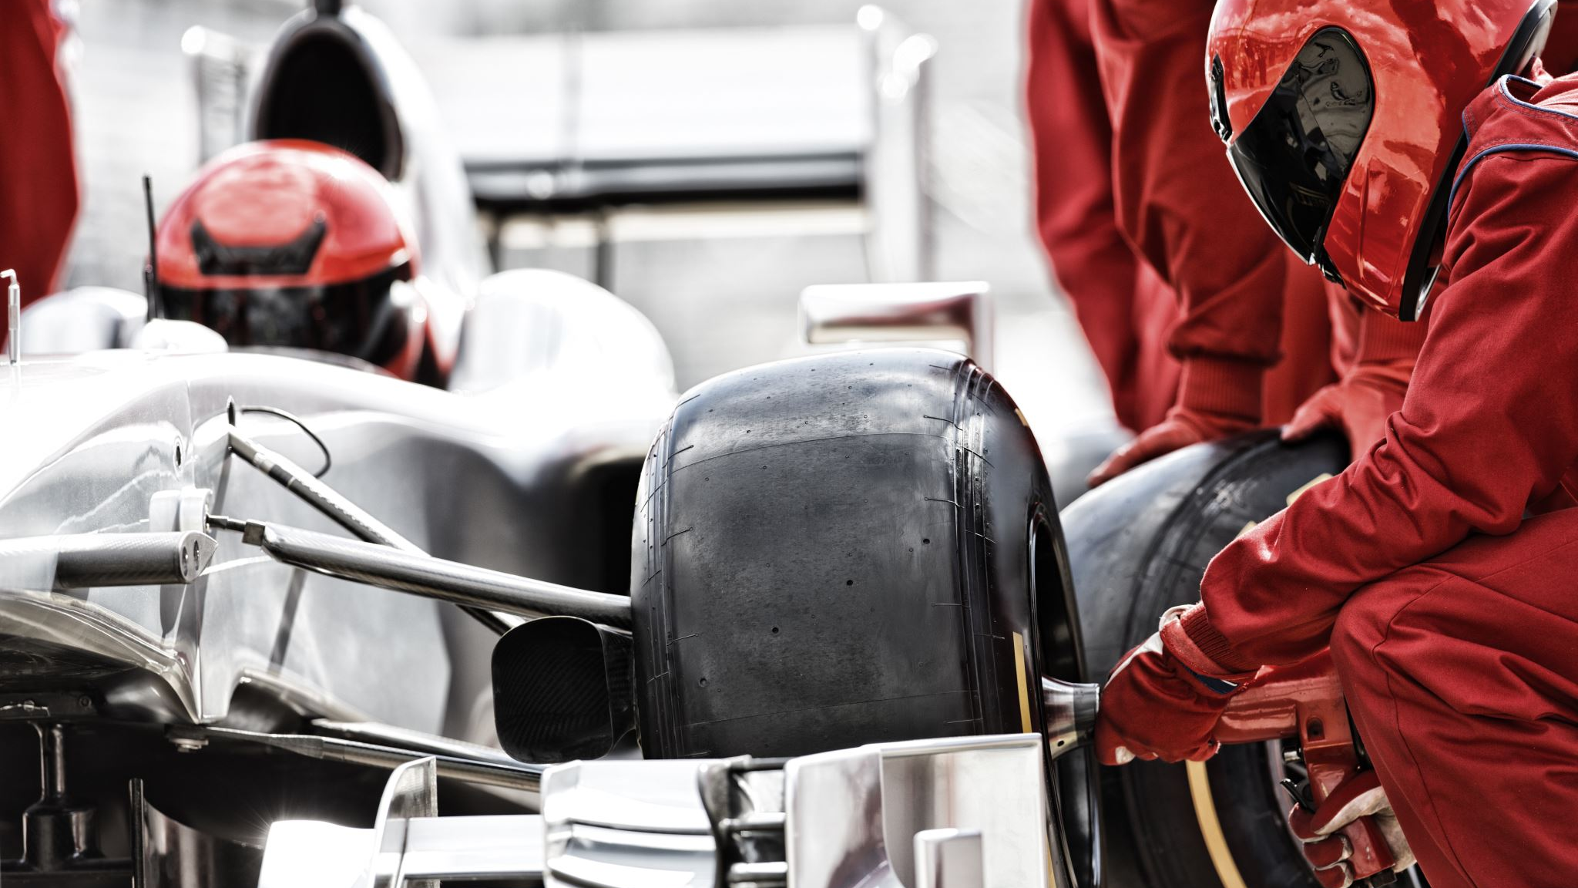
Predicting the F1 2022 Season Champion
Karthik Challa
Mehmet Inan
Carlie Iskandar
Rishabh Salwan

Slide 2
Agenda
Data explanation and processing
Challenges with the data
Model 1 explanation: 4 race data
Model 2 explanation: Lost n season’s data
Conclusion
Some fun facts

Slide 3
Data Explanation and Processing
Steps to our Final Dataset
Data Source
Scraping
Merge & Join
Features indicating champion
ML Model
- From 1950 – 2020
- Train and test data
- Drivers’ file
- Constructors’ file
- Race results’ file
- Pit stop file
- Winner of first 2 races
- Winner of first race
- Point difference
- Total pole positions
- etc.…
Comparison of 2 different models:
Lost n seasons’ data
4 race data

Slide 4
Some Challenges with the data
Gaps in the timeline data
Missing qualification data
Name Changes for some teams:
Steward – Jaguar – Redbull
Unclassified data for some features
140 different types of retirement from the race
Notes:
Missing qualification data
Unclassified data for many features (140 different types of retirement from race)

Slide 5
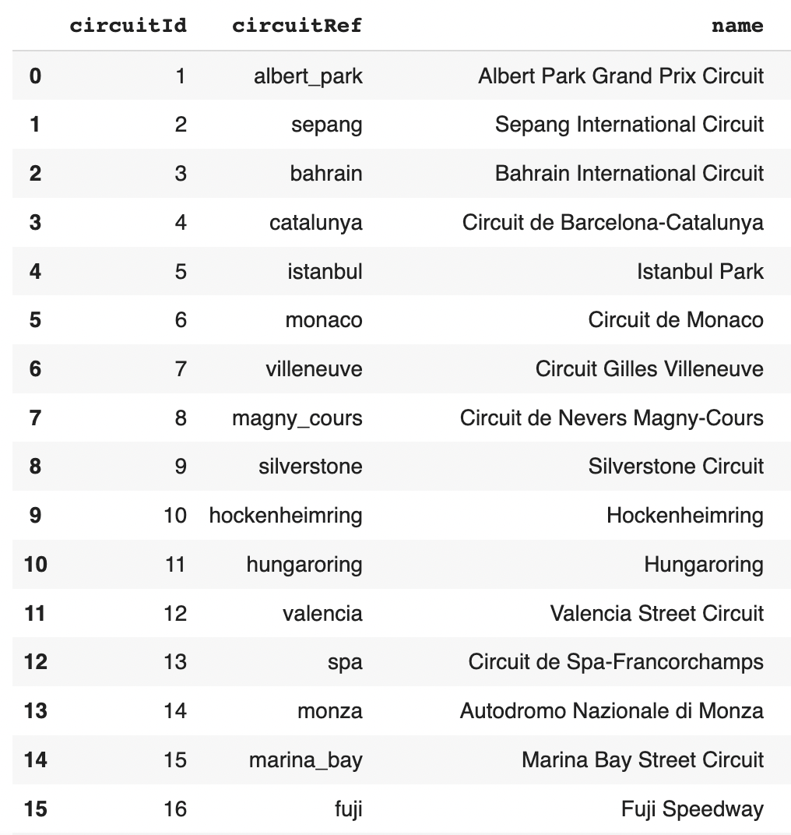
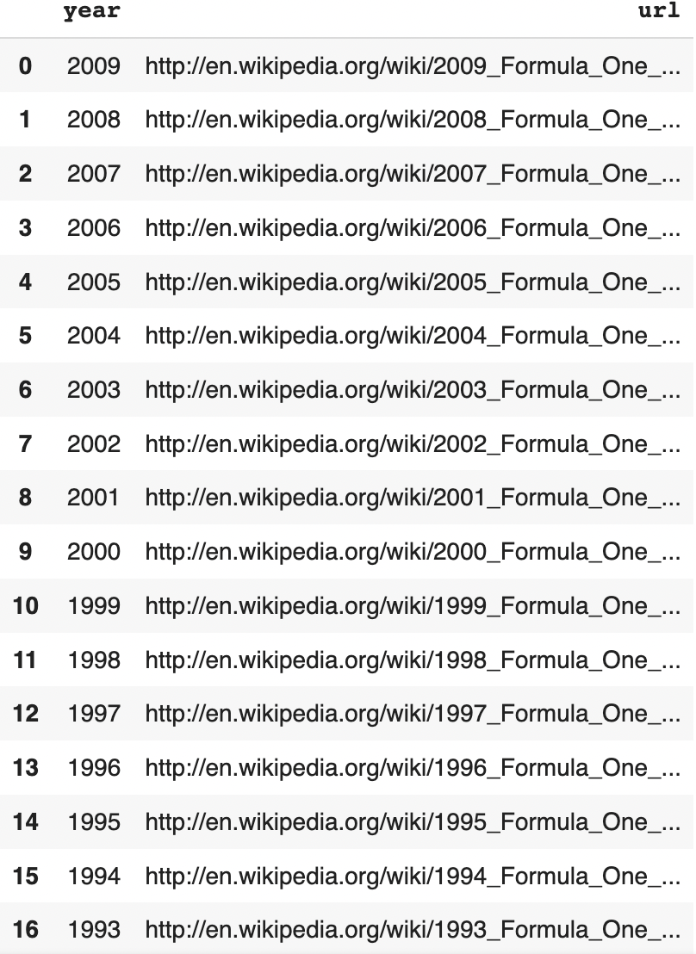
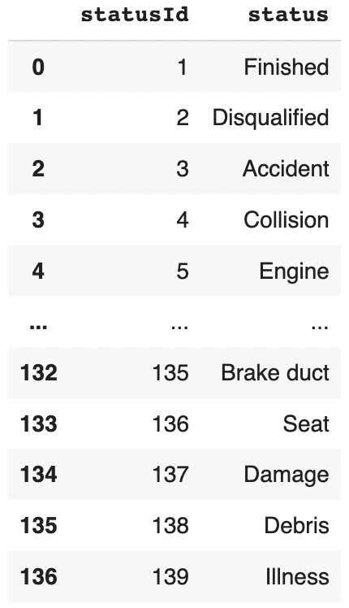

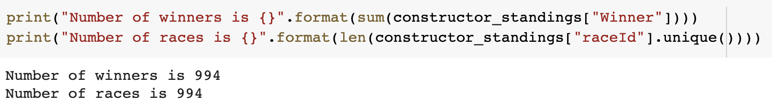
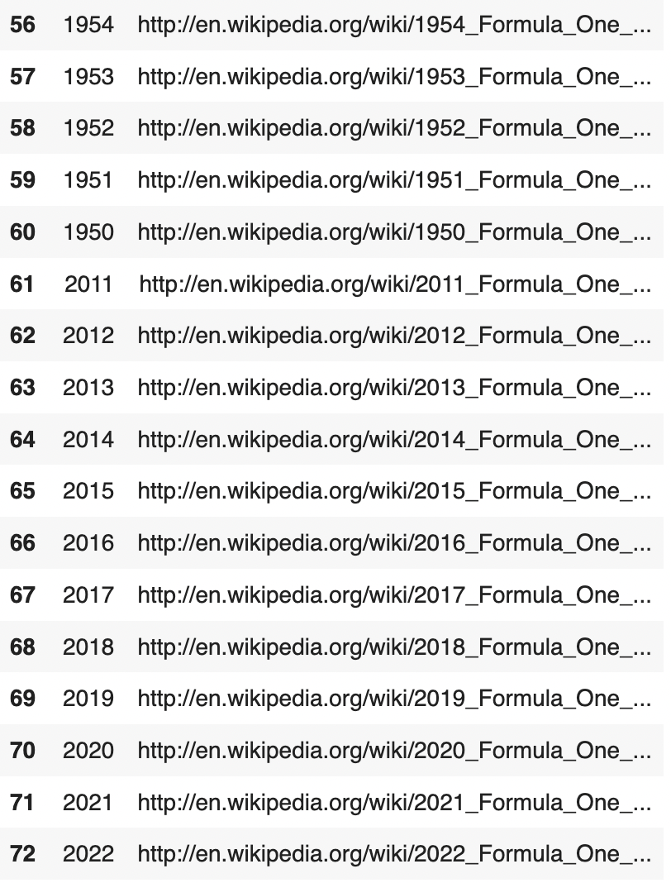
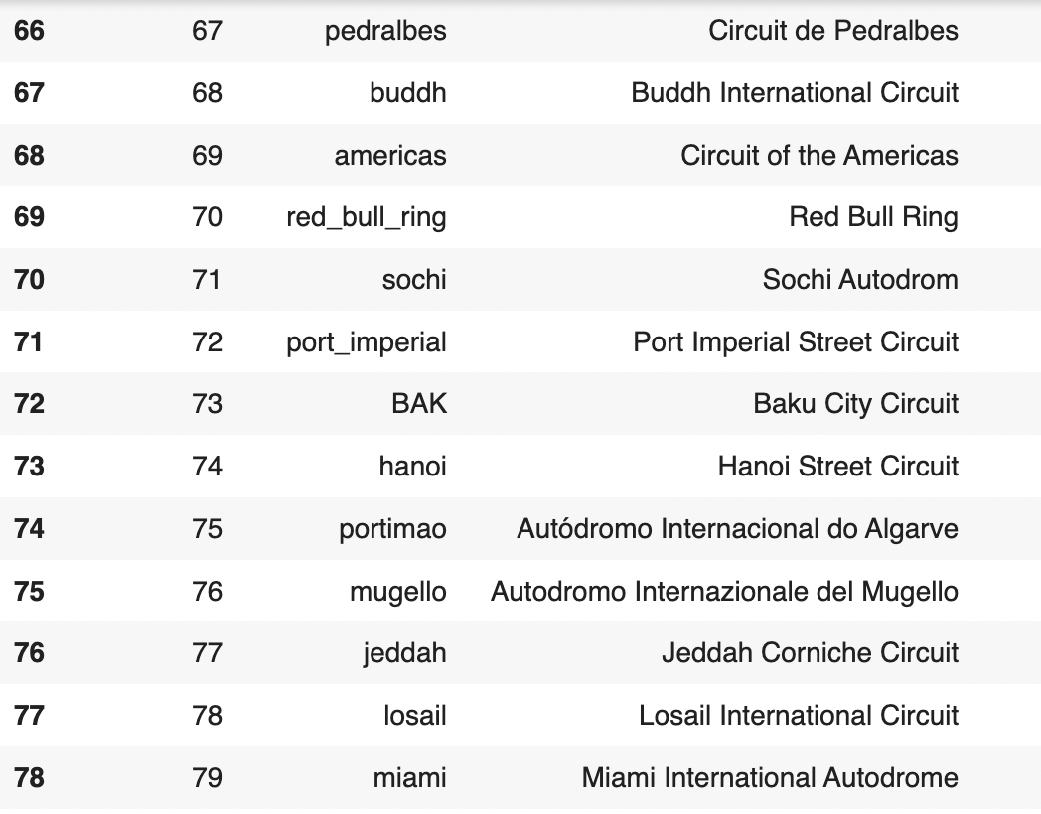
Fun Facts
Total number of circuits
78
Total number of races and results
994
Total number of seasons
72
Number of different racer status
137: Finished, Disqualified, Injured, Illness…
Notes:
We think that xxxxx will cause the delay. We want to know which ones have more significant impact.
Lead to our exploratory anlysis
Also lead to the features we chose for the model
Here is the page and format for general insight, left could be graphs
*** with caveats (top 50 airports from 2018 – 2019)
*Fun facts:
What percent of flight is delayed for the past year
Which airline has the highest delay rate
Which airport suffers the most delay
Which airline has on average the oldest plane
Which is the biggest airline flying domestic USA in regards of volume
Which day of week/ time of day tend to have worst delay
Which feature has the highest impact on delay
******WE STILL NEED!!! :
What percent of flight is delayed for the past year = 19.32%
Which airline has on average the oldest plane = Delta = 1987
Which airline has on average the oldest plane on average = Delta : median = 2001. Plane median age = 18 years
Which day of week/ time of day tend to have worst delay: Friday has highest delay rate

Slide 6
Other Fun Facts
Mercedes’ domination over the years

Slide 7
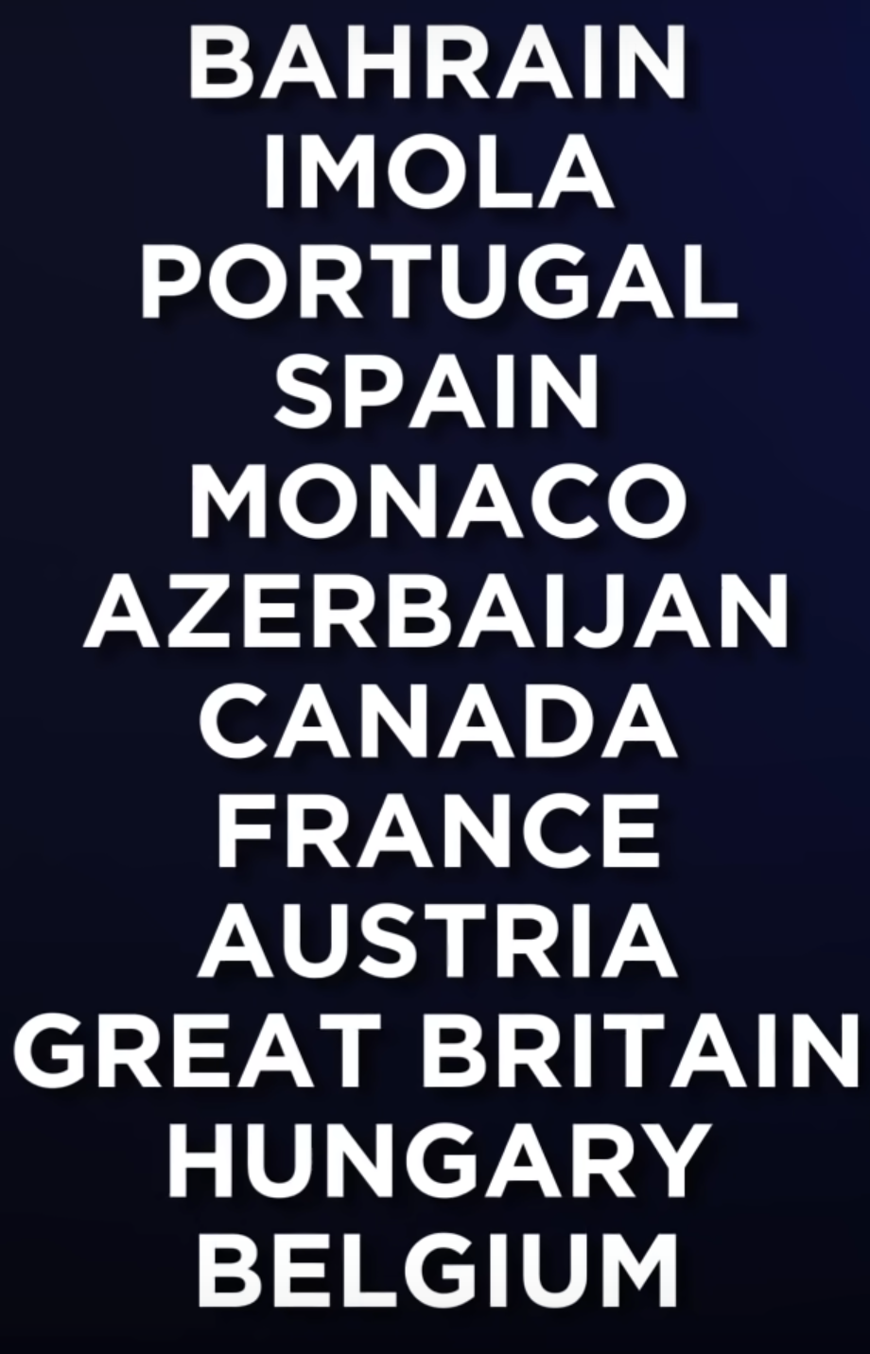
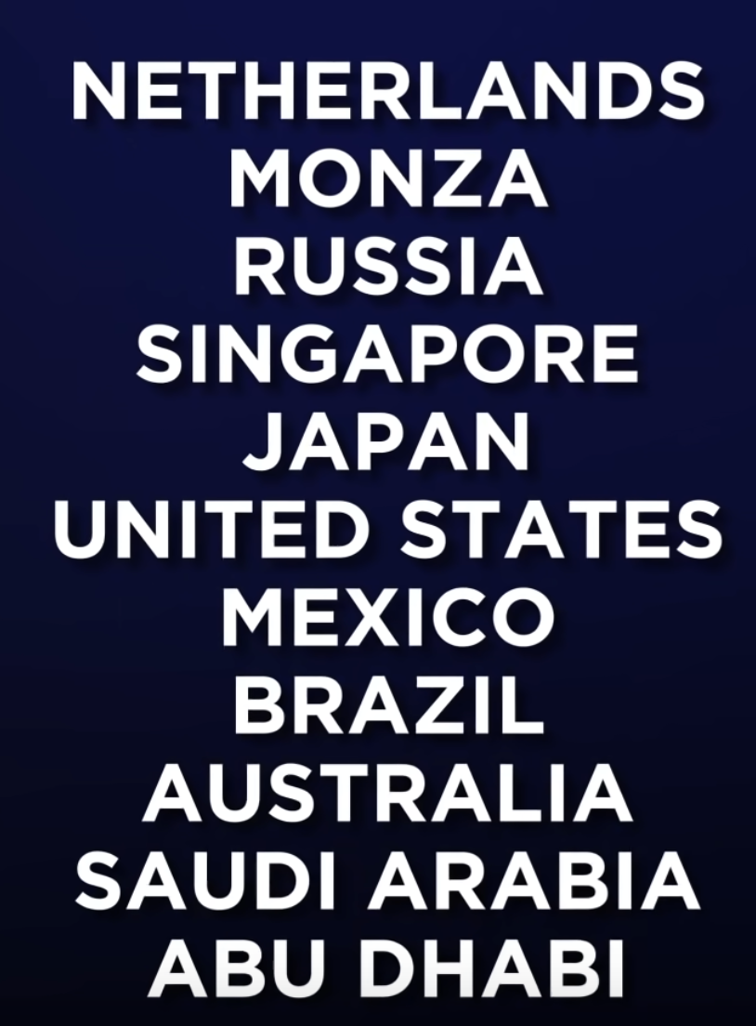
Power vs. Downforce Circuits
The ideal car would produce as much downforce as possible to boost speed through the corners, but without creating too much aerodynamic drag.
Power Circuits
Downforce Circuits

Slide 8




Timeline
1984 – 1991
McLaren → 13%
1999 – 2004
Ferrari → 20%
2010 – 2013
1992 – 1997
Redbull → 11%
Williams → 6%
2014 – 2019
Mercedes → 50%

Slide 9

Model 1: Lost n seasons’ data
Feature Engineering
Form graph
Include graphs: one with grid and one without
Adding some features: imp race, downforce race, motor Race/…
Remove insignificant ones
Model improvement: 54% → 56%
Model Explanation
Model takes into considerations the number of seasons a team has lost in total and predicts the winner of the next season
Using constructor data: team data → winning team (69%)
Using driver data → winning driver (54%)
Results and Validity
- Variables important to predict winner
Final accuracy for model developed
best accuracy for n – 1year
Constructor data → accuracy 69%

Slide 10
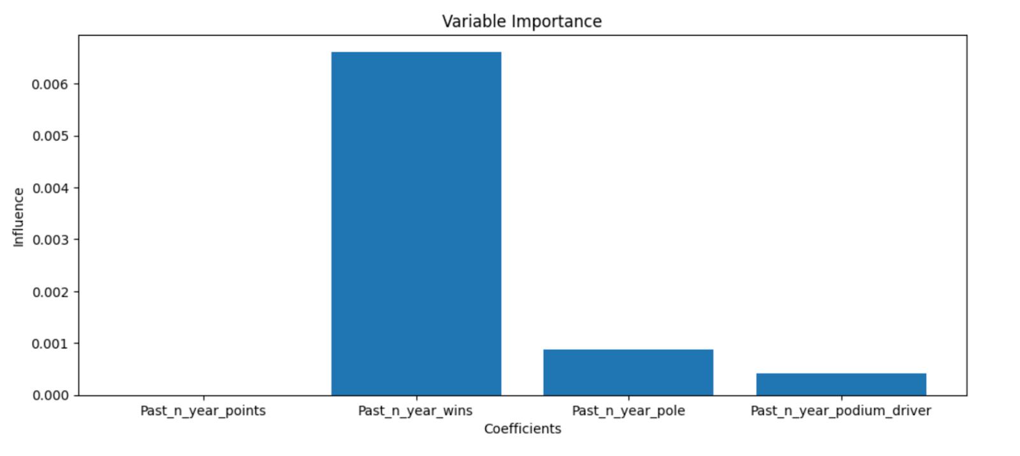
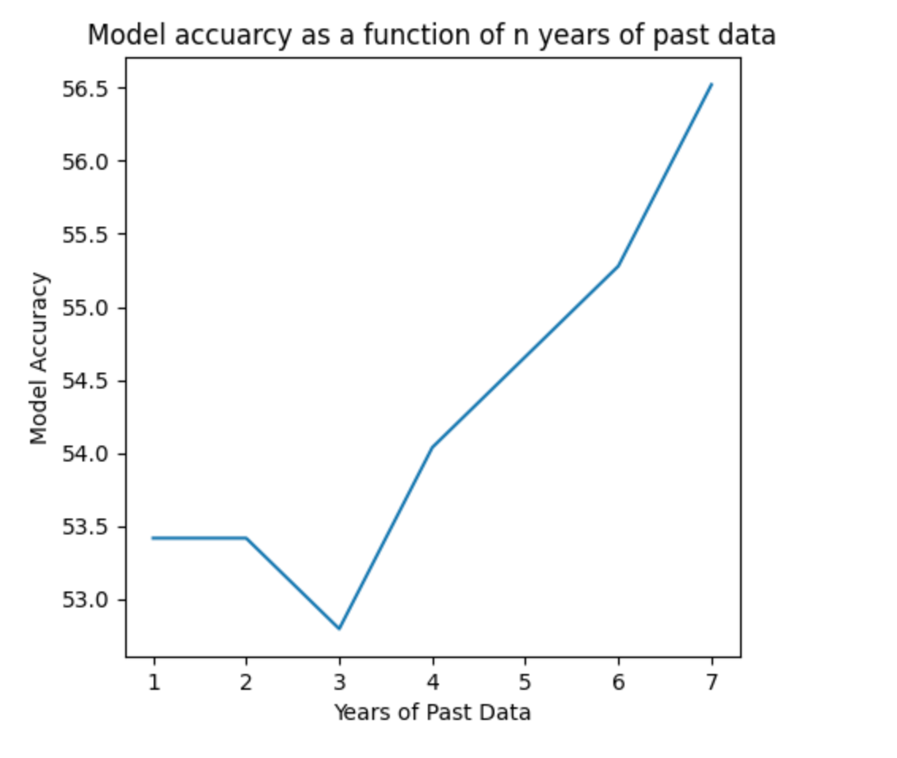
Feature Engineering
Variable Importance for Team win prediction without grid
Grid
Past n years wins
Mercedes dominance
Past n years podiums
Past n years pole position
Qualifying time
Ferrari dominance
Downforce races
Important races
Driver finish
Mixed race
Motor race
Constructor fault
Driver fault

Slide 11

Conclusion
Model 1 was successful:
2021 Prediction was accurate
2022 Prediction
Next Steps
Work on Model 2: 4 races data
Execute and compare
Model 2 was successful:
2021 Prediction was accurate
2022 Prediction

Slide 12
Season Winner and First Five Races Results
1986 – Honda
Alain Prost
Retired
3rd position
1st position
1990 – Honda
Ayrton Senna
1st position
1st position
6th position
3rd position
Retired
1st position
1st position
2009 – Mercedes
Jenson Button
1st position
1st position
1st position
3rd position
1st position
2017 – Mercedes
Lewis Hamilton
2nd position
1st position
2nd position
4th position
1st position

Slide 13
Model 2: 4 race data
Features
Model consists of the following features:
Winner of first 2 races
Winner of first race
Point difference after the first 3 races
Model Explanation
Model takes into consideration the first 4 races of the season and predicts the winner of that year
Results and Validity
Model

Slide 14
References
https://www.kaggle.com/datasets/rohanrao/formula-1-world-championship-1950-2020
https://www.kaggle.com/code/anandaramg/f1-champ-eda-classification-100-accuracy
https://towardsdatascience.com/machine-learning-to-predict-if-a-f1-driver-will-score-e741f057494d

